Slide 1

Web Application Development
COMP-229
Fall 2023

Slide 2
Create a folder by name WEEK12-CHATBOT
Open the folder in vscode
OR
Create a folder in vscode by name WEEK12-CHATBOT
Step 1: Create a New Vite Project
Open your terminal and run the following command:
npm create vite@latest chatbot --template react
or with yarn:
yarn create vite chatbot --template react
This command creates a new directory named chatbot with a basic React setup using Vite.

Slide 3
Step 2: Navigate to Your Project Directory
cd chatbot
Step 3: Install Dependencies
npm install
or
yarn
Step 4: Install Axios
You'll need Axios to handle API requests:
npm install axios

Slide 4
Project Structure
Once the installation is complete, you will see a project structure similar to this:
chatbot
├── node_modules
├── public
│ └── index.html
├── src
│ ├── App.css
│ ├── App.jsx
│ ├── index.css
│ └── main.jsx
├── .gitignore
├── index.html
├── package.json
├── README.md
└── vite.config.js

Slide 5
Explanation of Key Files:
index.html: The main HTML file.
main.jsx: Entry point for the React application.
App.jsx: Main component file.
vite.config.js: Configuration file for Vite.
5. Running the Development Server
To start the development server, run:
npm run dev
or
yarn dev
You should see output indicating the server is running, and you can open your browser to http://localhost:5173 to view your React app.

Slide 6
src/App.jsx
6. Create the Chat Component
Replace the contents of src/App.jsx with the following code:
import React, { useState } from 'react';
import axios from 'axios';
import './App.css';
const App = () => {
const [messages, setMessages] = useState([]);
const [userInput, setUserInput] = useState('');
const sendMessage = async () => {
if (!userInput.trim()) return;

Slide 7
src/App.jsx contd.
const newMessage = { text: userInput, sender: 'user' };
setMessages([...messages, newMessage]);
setUserInput('');
try {
const response = await axios.post('http://your-backend-url/chat', { message: userInput });
const aiMessage = { text: response.data.response, sender: 'ai' }; // Adjust based on your response format
setMessages(prevMessages => [...prevMessages, aiMessage]);
}

Slide 8
src/App.jsx contd.
catch (error) {
console.error('Error:', error);
const errorMessage = { text: 'Error communicating with AI.', sender: 'ai' };
setMessages(prevMessages => [...prevMessages, errorMessage]);
}
};

Slide 9
src/App.jsx contd.
return (
<div className="chat-container">
<div className="chat-box">
{messages.map((msg, index) => (
<p key={index} className={msg.sender}>
{msg.sender === 'user' ? 'You: ' : 'AI: '}{msg.text}
</p>
))}
</div>

Slide 10
src/App.jsx contd.
<input
type="text"
value={userInput}
onChange={e => setUserInput(e.target.value)}
placeholder="Type your message here..."
onKeyPress={e => {
if (e.key === 'Enter') sendMessage();
}}
/>
<button onClick={sendMessage}>Send</button>
</div>
);
};
export default App;

Slide 11
src/App.css
Step 7: Style the Chat Component
You can add some basic styling in src/App.css:
body {
font-family: Arial, sans-serif;
background-color: #f4f4f4;
margin: 0;
padding: 0;
}

Slide 12
src/App.css contd.
.chat-container {
width: 400px;
margin: 50px auto;
background: white;
border-radius: 8px;
box-shadow: 0 0 10px rgba(0, 0, 0, 0.1);
padding: 10px;
}

Slide 13
src/App.css contd.
.chat-box {
height: 300px;
overflow-y: auto;
padding: 10px;
border-bottom: 1px solid #ddd;
}
.chat-box p {
margin: 0;
padding: 5px;
}

Slide 14
src/App.css contd.
.chat-box .user {
text-align: right;
color: green;
}
.chat-box .ai {
text-align: left;
color: blue;
}

Slide 15
src/App.css contd.
input[type="text"] {
width: calc(100% - 80px);
padding: 10px;
border: 1px solid #ddd;
border-radius: 4px;
}

Slide 16
src/App.css contd.
button {
padding: 10px 20px;
border: none;
background-color: #007bff;
color: white;
border-radius: 4px;
cursor: pointer;
}
button:hover {
background-color: #0056b3;
}

Slide 17
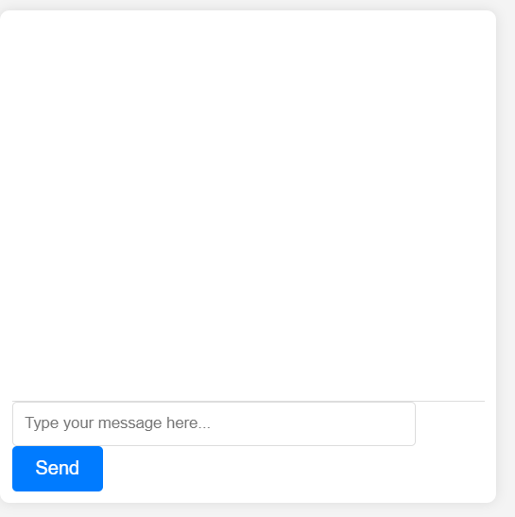
Step 8: Run Your React App
Yarn dev
Or
npm run dev

Slide 18
BACKEND CODE
Here’s a simple Express.js backend that you can use with the React app. This backend will handle incoming chat messages and communicate with the Google Generative AI API.
Open a new terminal
First, create a new directory for your backend at the root/terminal
Set Up the Backend
mkdir chatbot-backend
cd chatbot-backend
Initialize a new Node.js project:
npm init -y

Slide 19
2. Install Required Packages
Install the necessary packages:
npm install express body-parser cors @google/generative-ai

Slide 20
server.js
3. Create the Server Code
Create a file named server.js in the chatbot-backend directory and add the following code:
const express = require('express');
const bodyParser = require('body-parser');
const cors = require('cors');
const { GoogleGenerativeAI, HarmCategory, HarmBlockThreshold } = require('@google/generative-ai');
const app = express();
const PORT = process.env.PORT || 5000;

Slide 21
server.js contd.
const MODEL_NAME = "gemini-1.0-pro";
const API_KEY = "YOUR_API_KEY"; // Replace with your actual API key
const GENERATION_CONFIG = {
temperature: 0.9,
topK: 1,
topP: 1,
maxOutputTokens: 2048,
};

Slide 22
server.js contd.
const SAFETY_SETTINGS = [
{ category: HarmCategory.HARM_CATEGORY_HARASSMENT, threshold: HarmBlockThreshold.BLOCK_MEDIUM_AND_ABOVE },
{ category: HarmCategory.HARM_CATEGORY_HATE_SPEECH, threshold: HarmBlockThreshold.BLOCK_MEDIUM_AND_ABOVE },
{ category: HarmCategory.HARM_CATEGORY_SEXUALLY_EXPLICIT, threshold:

Slide 23
server.js contd.
HarmBlockThreshold.BLOCK_MEDIUM_AND_ABOVE },
{ category: HarmCategory.HARM_CATEGORY_DANGEROUS_CONTENT, threshold: HarmBlockThreshold.BLOCK_MEDIUM_AND_ABOVE },
];
app.use(cors());
app.use(bodyParser.json());

Slide 24
server.js contd.
app.post('/chat', async (req, res) => {
const userMessage = req.body.message;
try {
const genAI = new GoogleGenerativeAI(API_KEY);
const model = genAI.getGenerativeModel({ model: MODEL_NAME });
const chat = model.startChat({
generationConfig: GENERATION_CONFIG,
safetySettings: SAFETY_SETTINGS,
history: [],
});

Slide 25
server.js contd.
const result = await chat.sendMessage(userMessage);
if (result.error) {
return res.status(500).json({ error: result.error.message });
}
const responseText = result.response.text();
res.json({ response: responseText });
} catch (error) {
res.status(500).json({ error: error.message });
}
});

Slide 26
server.js contd.
app.listen(PORT, () => {
console.log(`Server is running on http://localhost:${PORT}`);
});

Slide 27
API-KEY
API-KEY
Get a Gemini API key from google API using the following link
https://ai.google.dev/gemini-api/docs/api-key

Slide 28
4. Run Your Backend
At the terminal/root
cd chatbot-backend
Make sure to replace YOUR_API_KEY with your actual API key. Then, start your server:
Using the following command:
node server.js

Slide 29
5. Connect the Frontend
Ensure your React app is pointing to the correct backend URL (e.g., http://localhost:5000/chat).
6. Notes
Make sure to handle CORS and ensure the backend is running when you access the React app.
This setup should provide a functional chat interface using the Google Generative AI API.
To connect your Vite frontend with your Express backend, you can set up a proxy in your vite.config.js. This allows you to make API calls to your backend without running into CORS issues during development. Here’s how to do it:

Slide 30
1. Install Vite
Install vite using the following command:
npm install @vitejs/plugin-react
OR
if you have already spin up your react application using vite, configure the proxy to the server
2. Configure Proxy in vite.config.js
Open or create the vite.config.js file in the root of your Vite project (the frontend) and add a proxy configuration for your backend API as follows:

Slide 31
vite.config.js
import { defineConfig } from 'vite';
import react from '@vitejs/plugin-react';
export default defineConfig({
plugins: [react()],
server: {
proxy: {
'/chat': {
target: 'http://localhost:5000', // URL of your backend
changeOrigin: true,
rewrite: (path) => path.replace(/^\/chat/, ''),
},
},
},
});

Slide 32
3. Update API Calls in Your React App
In your React app, when you make API calls, you can now use the proxy. For example, in src/App.jsx, update your API call to:
//const response = await axios.post('/chat', { message: userInput });
const response = await axios.post('http://localhost:5000/chat', { message: userInput });

Slide 33
4. Start Both the Frontend and Backend
Make sure your Express backend is running on http://localhost:5000, and then start your Vite frontend:
npm run dev
or
yarn dev
Summary
With this configuration:
All requests to /chat from your frontend will be proxied to your backend at http://localhost:5000/chat.
This avoids CORS issues during development and keeps your code cleaner.

Slide 34
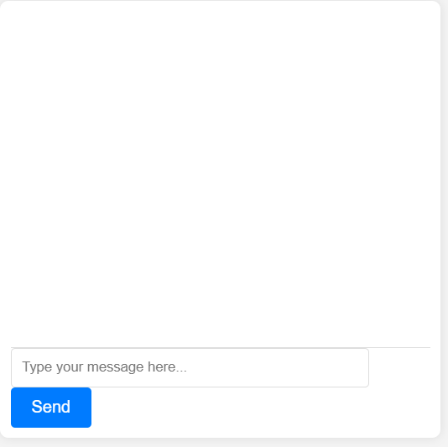
Output

Slide 35
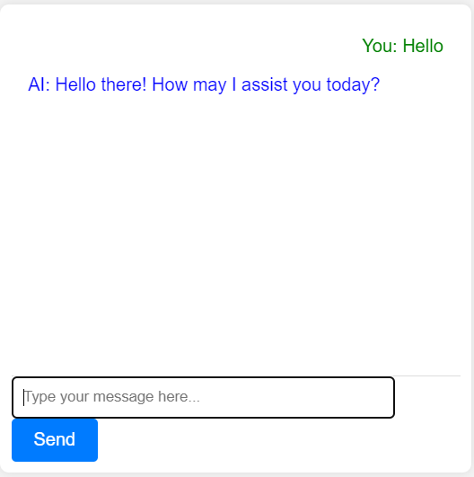

Slide 36
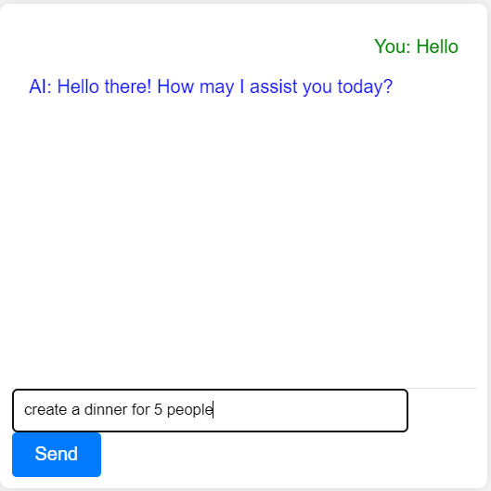

Slide 37
